Slide 1

Session 2 of 10
Hands-On Developing gRPC Service
and
Multiple Types of .NET Core Clients
Viswanatha Swamy
LinkedIn: https://www.linkedin.com/in/viswanatha-swamy-b57326128/
Twitter: https://twitter.com/vishipayyallore
XMonkeys360

Slide 2
Information
Today is session 2.
All the sessions will be hands on.
Sessions will be weekly.
Will have parking lots for queries and other topics.
Some of the concepts we will introduced and revisited in next sessions.
There are multiple ways to do, we will use one of the way.
The focus was more on concepts and demos are kept simple.
I am still a learner. What!!! … wait … Yes, I am still a learner.
XMonkeys360

Slide 3
Tools we use
Visual Studio 2019 Professional
Azure Data Studio
SQL Server
XMonkeys360

Slide 4

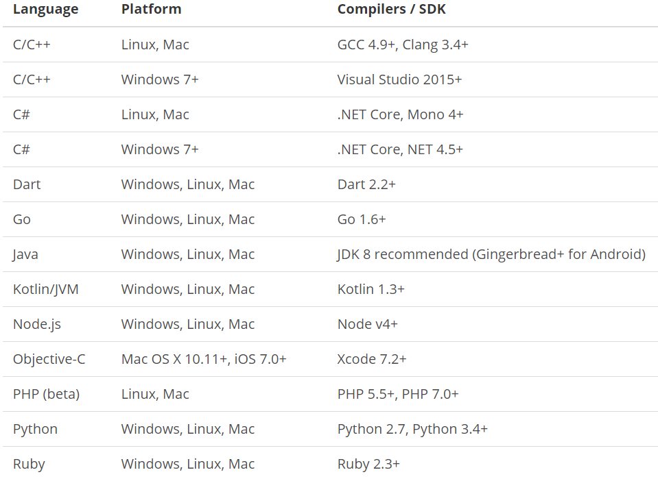
What is gRPC ?
is a modern open source high performance RPC framework that can run in any environment. It can efficiently connect services in and across data centers with pluggable support for load balancing, tracing, health checking and authentication. It is also applicable in last mile of distributed computing to connect devices, mobile applications and browsers to backend services.
https://docs.microsoft.com/en-us/aspnet/core/tutorials/grpc/grpc-start?view=aspnetcore-3.1&tabs=visual-studio
https://grpc.io/docs/guides/
https://grpc.io/docs/guides/concepts/
Motivation:
High Performance
IDL / Contract Based
Streaming (Unary, Client, Server, Bi-directional)
Security (https://developers.google.com/web/fundamentals/performance/http2)
Available across ecosystems
Supported Languages:
URL: https://grpc.io/about/#officially-supported-languages-and-platforms
XMonkeys360

Slide 5
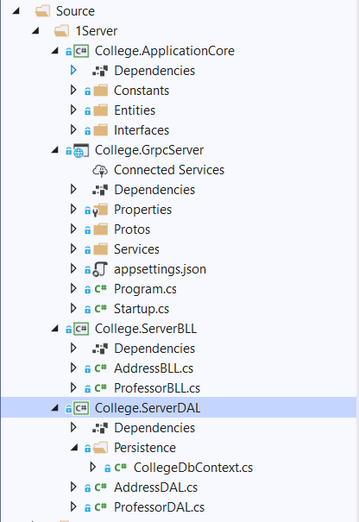
Improvising the gRPC Service into Layers
College.ApplicationCore:
Constants
Entities
Interfaces
College.GrpcServer:
.Proto files
gRPC Server implementations
Application Configuration
Start up and DI
College.ServerBLL:
Any Business Logic
College.ServerDAL:
Db Context
Data Access Layer which consumes Db Context
XMonkeys360

Slide 6
Improvising the gRPC Service into Layers
Demo
Improvising the gRPC Service
into Layers
XMonkeys360

Slide 7
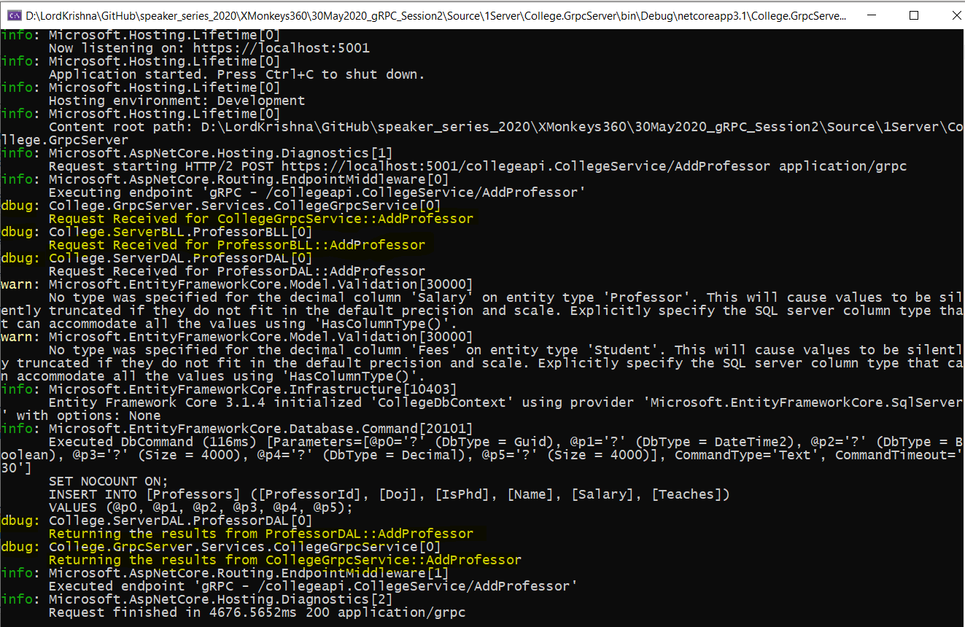
Adding Console Logging into gRPC Server and Client
XMonkeys360

Slide 8
Adding Console Logging into gRPC Server and Client
Demo
Adding Console Logging into
gRPC Server and Client
XMonkeys360

Slide 9
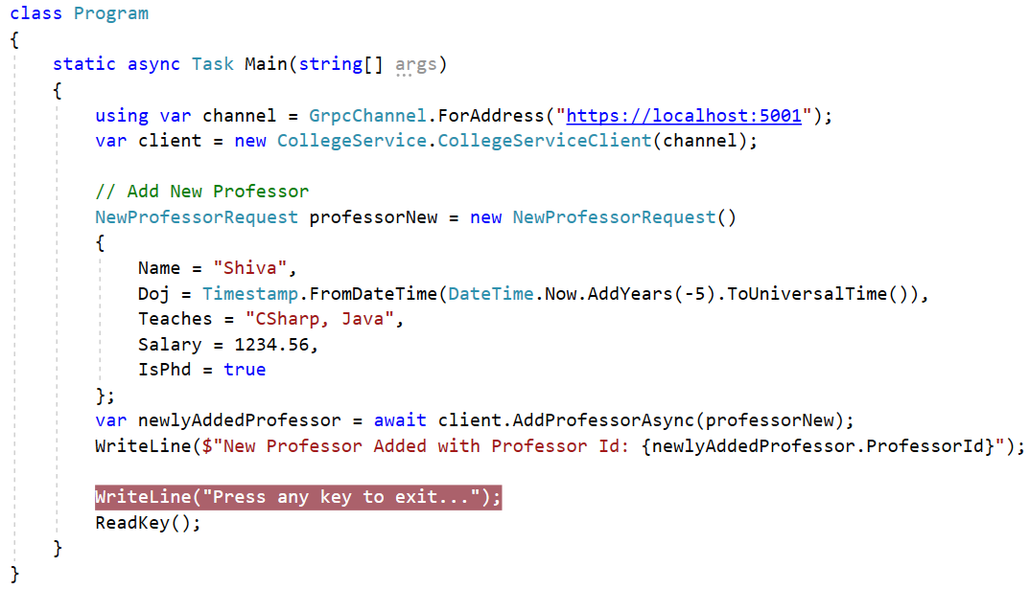
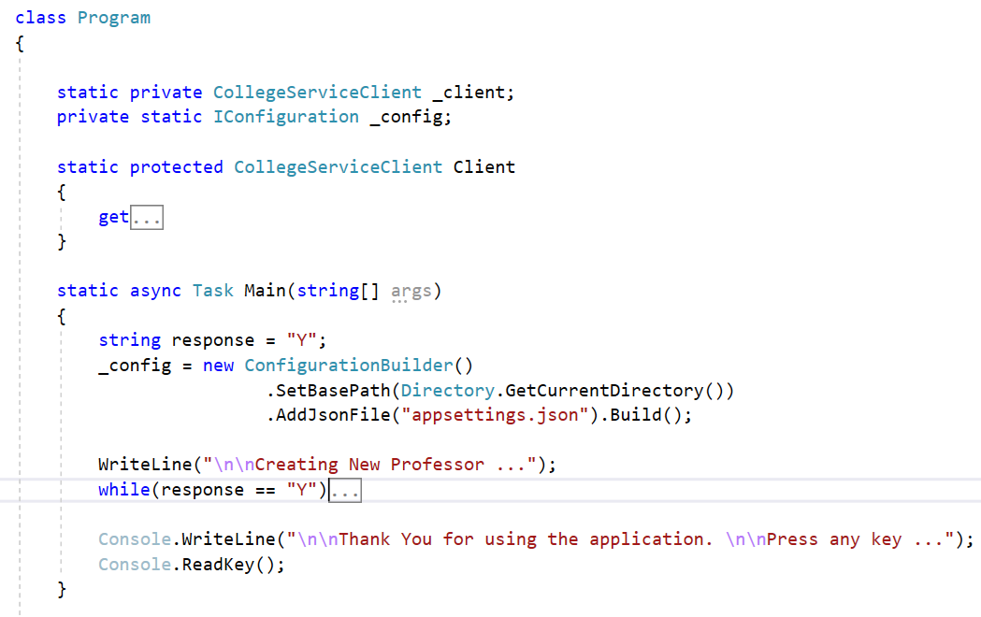
Improvising the gRPC Client
XMonkeys360

Slide 10
Improvising the gRPC Client
Demo
Improvising the gRPC Client
XMonkeys360

Slide 11
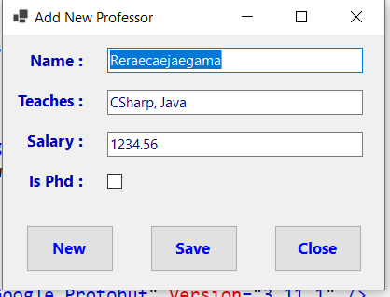
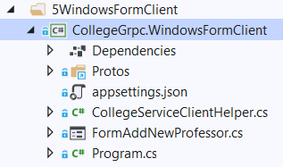
Windows Forms as gRPC Client
XMonkeys360

Slide 12
Windows Forms as gRPC Client
Demo
Windows Forms as gRPC Client
XMonkeys360

Slide 13
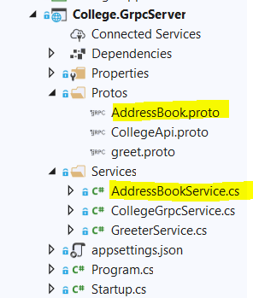
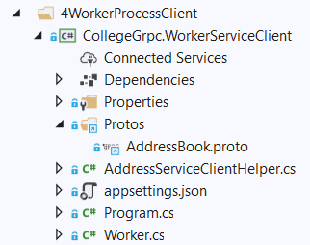
.NET Core Worker Process as gRPC Client
XMonkeys360

Slide 14
.NET Core Worker Process as gRPC Client
Demo
.NET Core Worker Process
as gRPC Client
XMonkeys360

Slide 15
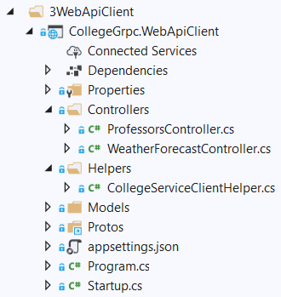
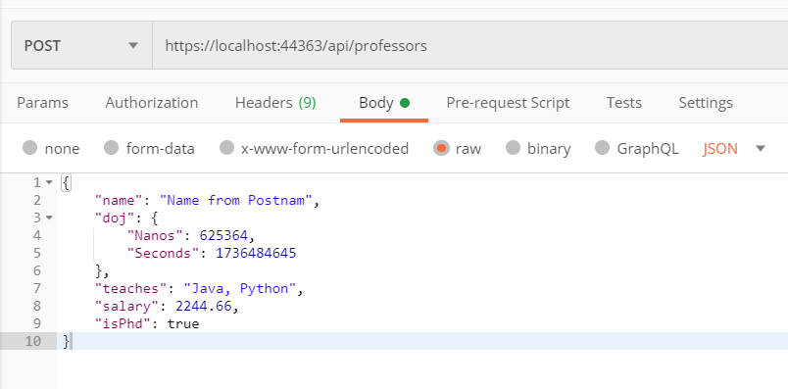
.NET Core Web API as gRPC Client
XMonkeys360

Slide 16
.NET Core Web API as gRPC Client
Demo
.NET Core Web API
as gRPC Client
XMonkeys360

Slide 17
What is next?
What is next ???
What we will discuss in next session ….
Adding GetById(), and GetAll() into .Proto file.
Implementing the functionality to return Single and Multiple Records into gRPC Server.
Setting up and verifying Redis Cache in our Laptop.
To Install on WSL on Windows 10
To Start and Stop the Redis Service
To connect to Redis Server
Improving the Retrieval Time by using Redis Cache.
Verify the Time of retrieval of data with and without Redis Cache.
XMonkeys360

Slide 18
Q & A
XMonkeys360

Slide 19
Thank You
Viswanatha Swamy
LinkedIn: https://www.linkedin.com/in/viswanatha-swamy-b57326128/
Twitter: https://twitter.com/vishipayyallore
XMonkeys360

